Slide 2
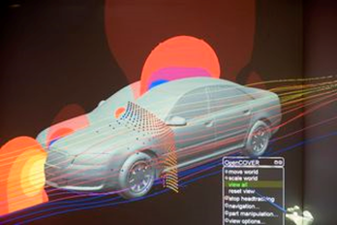
Acronym:
Title:
IMAGE EXAMPLE
please replace
Company:
Contact Person:

Slide 3
Motivation / Challenge:
Please describe the project motivation.
(e.g. forthcoming legislation setting , customer requirements,
internal regulations, cost-saving , faster product development)

Slide 4
The state of the art:
What has been achieved so far?

Slide 5
The new approch:
What method or process do you suggest?

Slide 6
Project goals / expected results:
Please describe the project goals.

Slide 7
Needed competences / partners:
Please describe the required and / or lacked competence.
What kind of project partner are you looking for?

Slide 8
Please tick as appropriate :
CAE degree of innovation
Use of HPC
IT
Numerics / Mathematics
Modelling
Process + Data
Visualization
CAE direction of impact
Closing methodological gaps
Improving performance
Increase forecasting accuracy
New application
Coupling application areas
Environmental relevance
Reduction of emissions
Reduction of noise
Resource-saving
CAE classification
CAE simulation
Optimization
Numerics and robustness
Multi physics
Other
Requirements
Legal requirements
Customer requirements
Internal regulations
Cost-saving
Faster product development

